Slide 1

Chaudhary Charan Singh University, Meerut, UttarPradesh
SIR CHOTTU RAM INSITUTE & ENGINEERING TECNOLOGY
PRESENTATION ON
EXAM PREP HELP ZONE
Presented By:- Guided By:-
Rashi Bhasin(100210748) Dr. Nidhi Bhatia
Himanshi Ahlawat(100210725)
MCA 4th sem.

Slide 2

List of Content
INTRODUCTON
SYSTEM SPECIFICATION
SYSTEM DESIGN
DATA FLOW DIAGRAM
STUDY MATERIAL
PREVIOUS YEAR QUSTION PAPERS
EXPERT GUIDENCE
COMMUNITY SUPPORT
PROBLEM FACED
SNAPSHORTS
FUTURE SCOPE
CONCLUSION

Slide 3


Slide 4
System
Specifications
Processor:
Intel i3
RAM:
256 MB
Hard Disk:
20GB
Monitor:
Color
Operating System:
Windows, Android, iOS
Front end: HTML, CSS, JavaScript
Back end:
MySQL
Server side:
PHP
Server:
Wamp

Slide 5
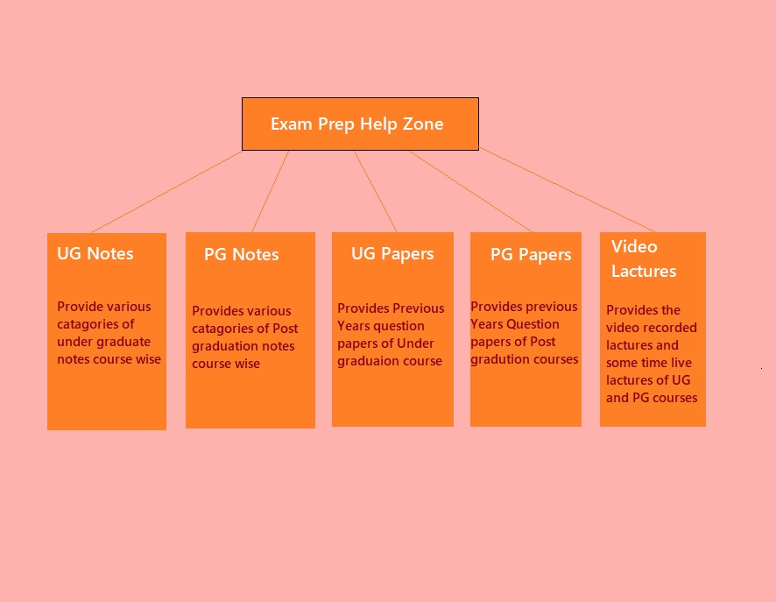
SYSTEM DESIGN

Slide 6
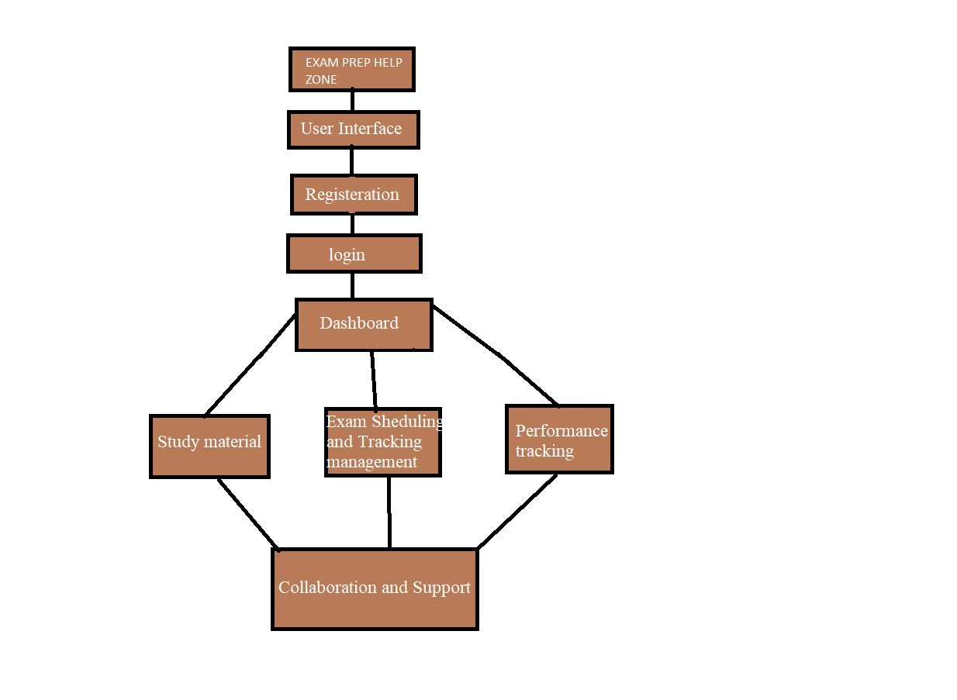
DATA FLOW DIAGRAM

Slide 7


Slide 8
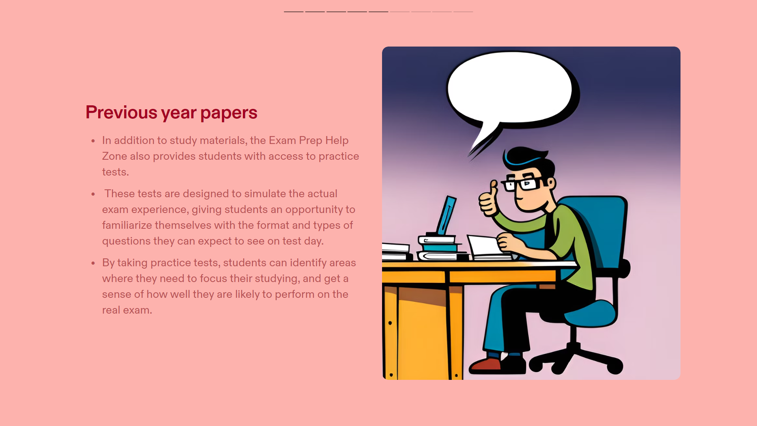

Slide 9


Slide 10


Slide 11
Problem Faced
1. Limited resources
2. Difficulty in engaging students
3. Maintaining quality assurance
4. Technical issues
5. Sustainability and funding
6. Balancing subject coverage
7. Evaluation and impact assessment.

Slide 12

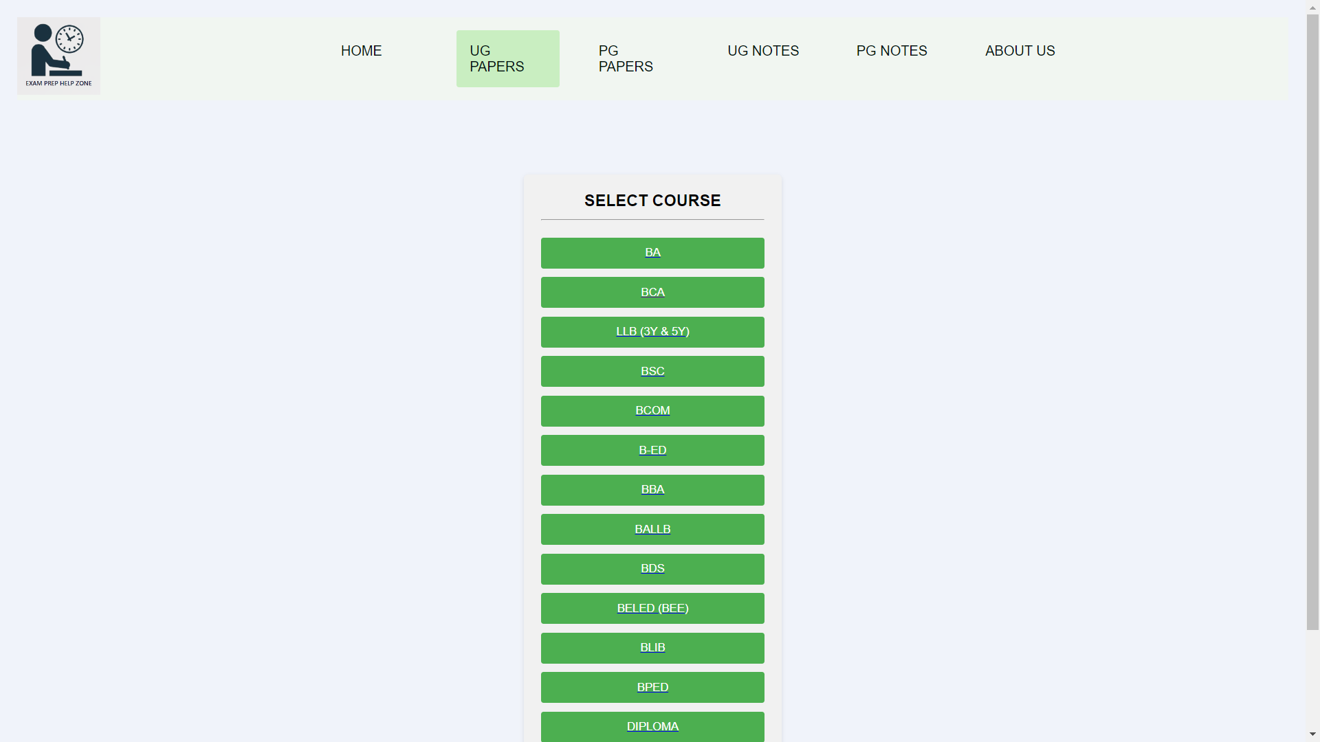
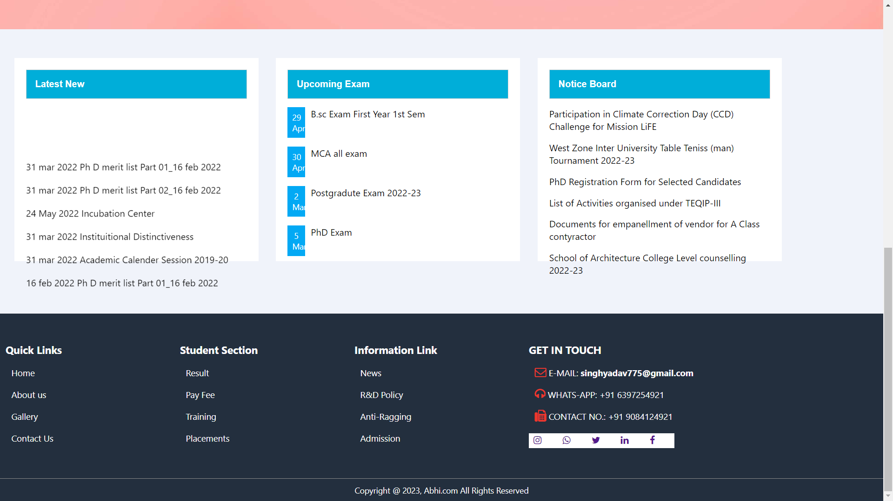
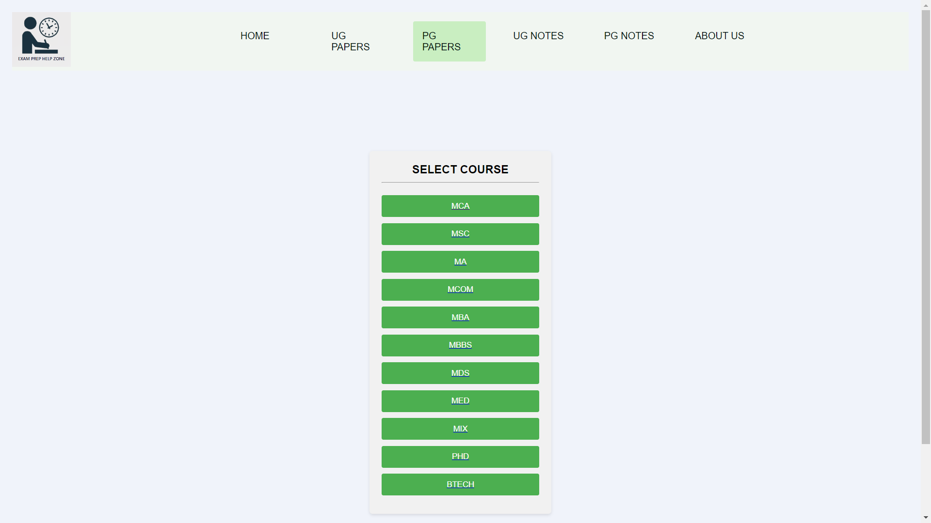
SNAPSHORTS

Slide 13
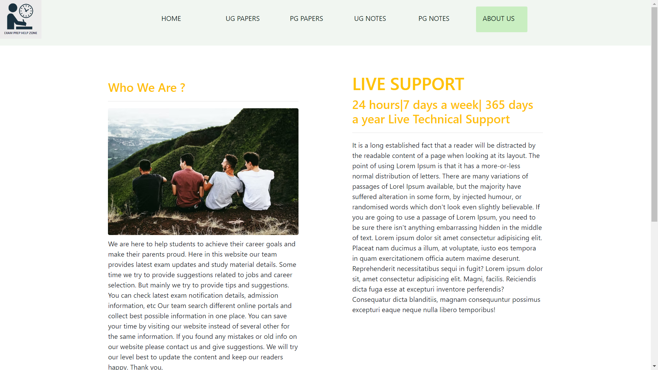
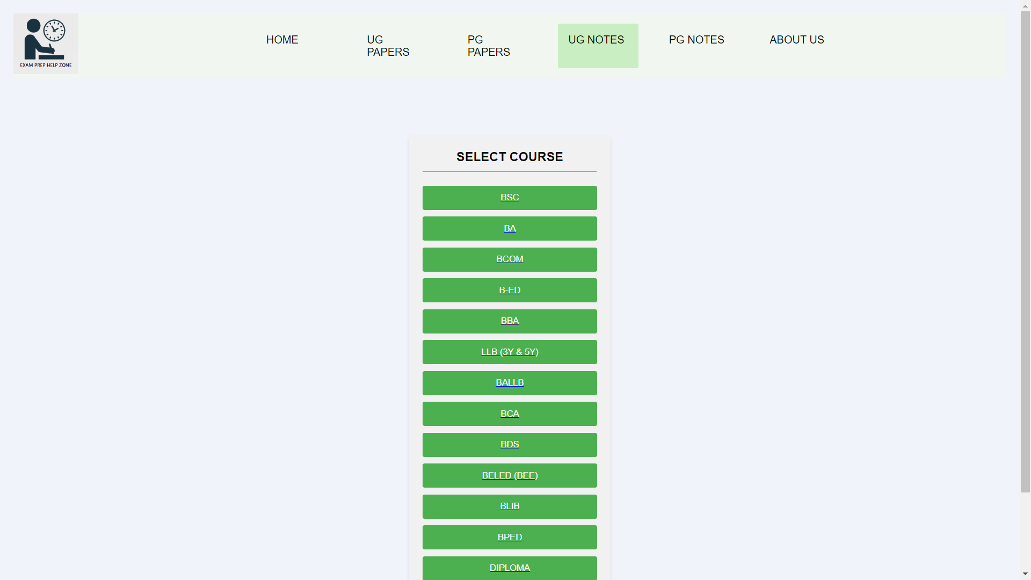
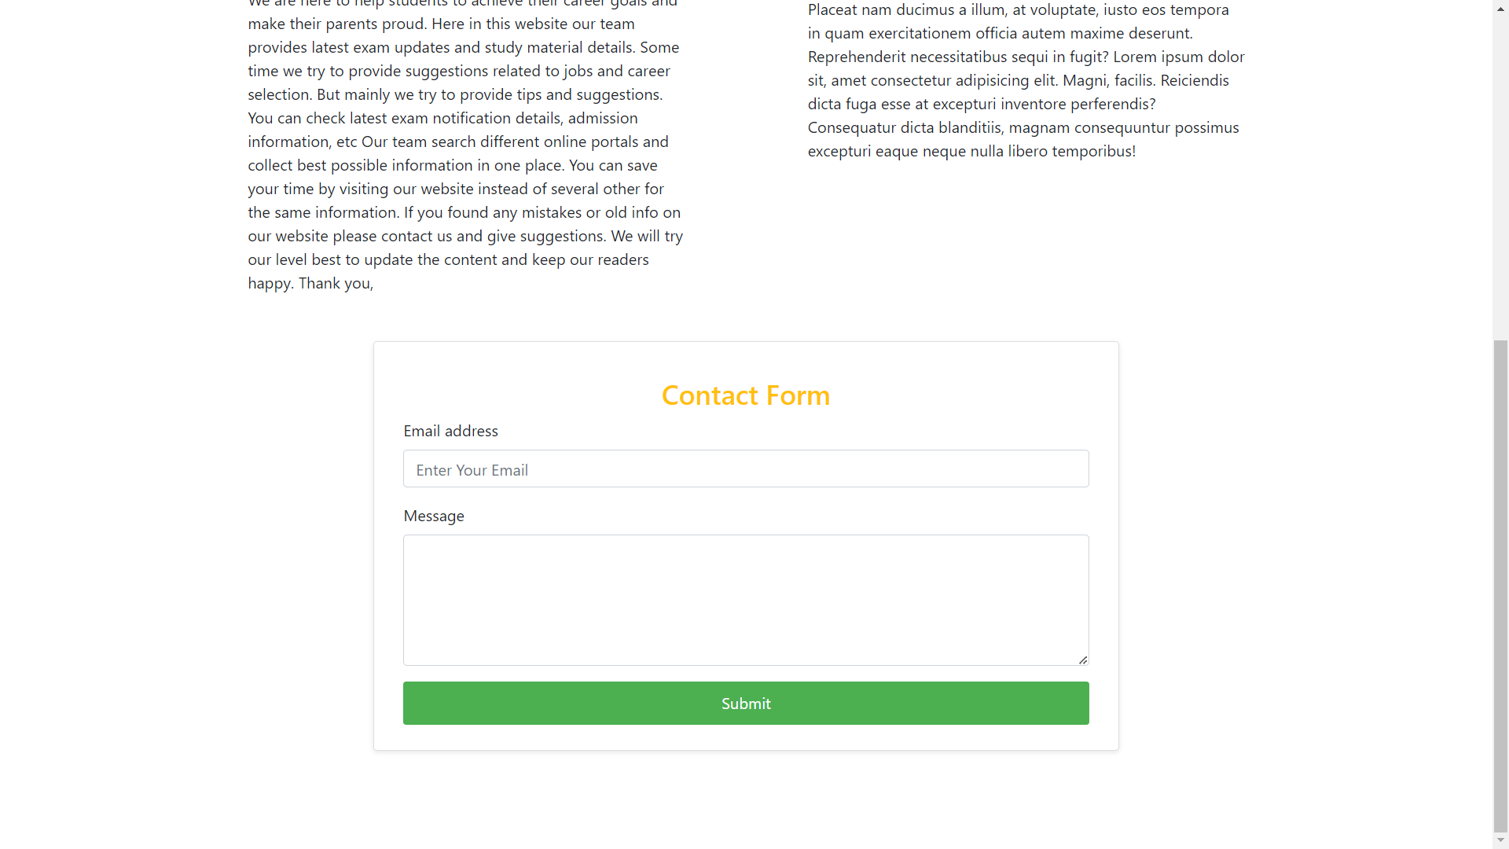
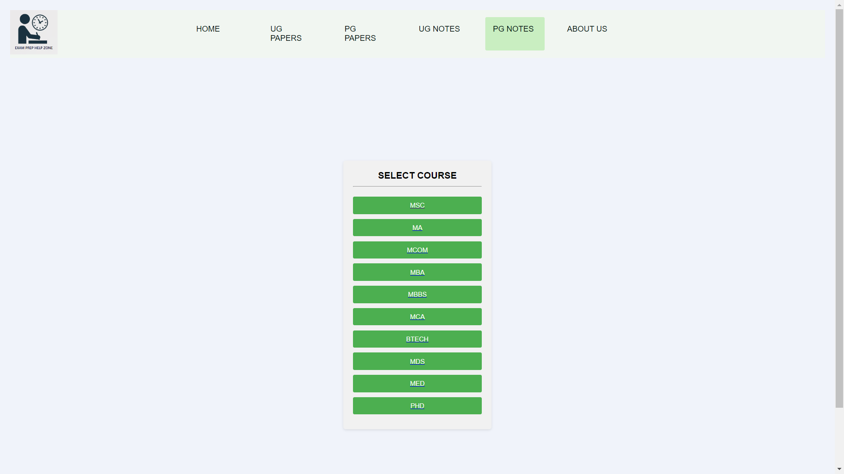
SNAPSHORTS

Slide 14
Future Scope
1. Integration with online learning platforms
2. Personalized learning experiences
3. Mobile application development
4. Collaboration with educational institutions
5. Expansion into additional languages and regions
6. Alumni mentorship and networking
7. Gamification and interactive
8. Research-based strategies

Slide 15


Slide 16


